Slide 1
What is?

Slide 2
Your Church deciding to:
Prepare

Slide 3
Your Church deciding to:
Connect

Slide 4
Your Church deciding to:
Respond

Slide 5
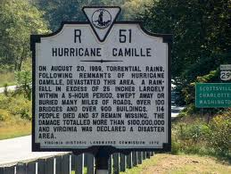
WHY?
Virginia has Floods

Slide 6
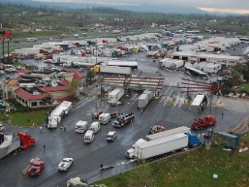
WHY?
Virginia has Tornados

Slide 7
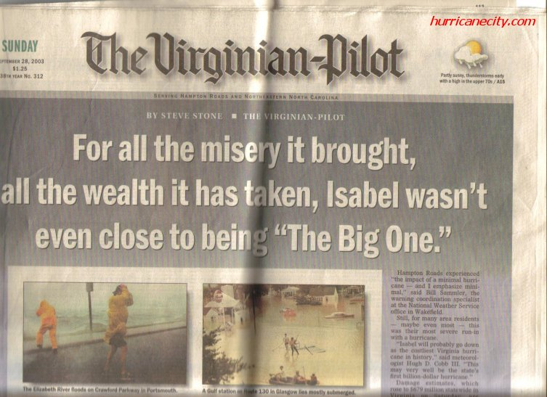
WHY?
Virginia has Hurricanes

Slide 8
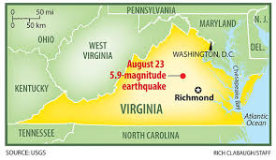
WHY?
Virginia has Earthquakes

Slide 9
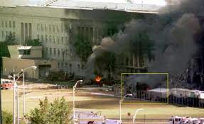
WHY?
Virginia has terror attacks

Slide 10
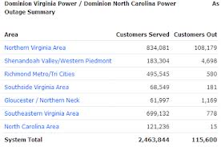
WHY?
Virginia has Massive Electrical Outages

Slide 11
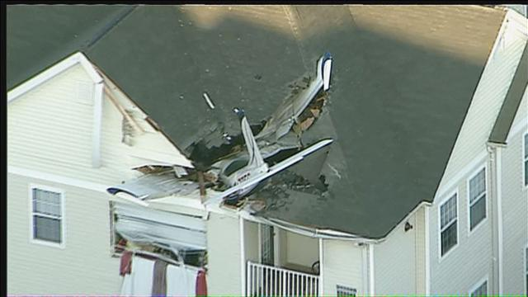
WHY?
Virginia has Plane Crashes

Slide 12
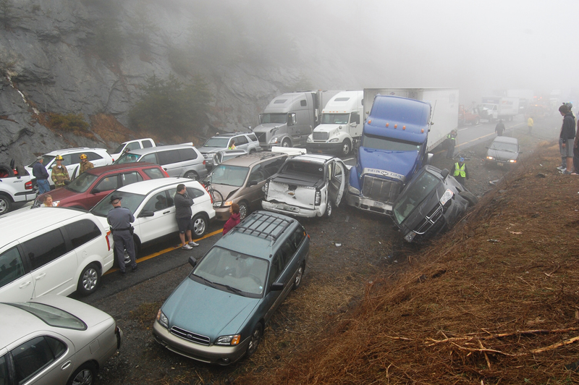
WHY?
Virginia has Massive Vehicle Crashes

Slide 13
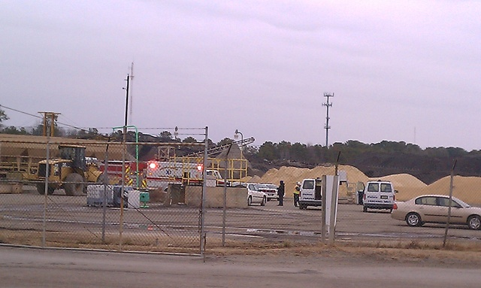
WHY?
Virginia has Industrial Accidents

Slide 14
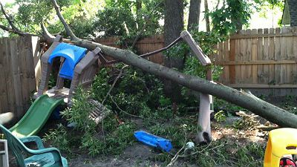
WHY?
Virginia has trees

Slide 15
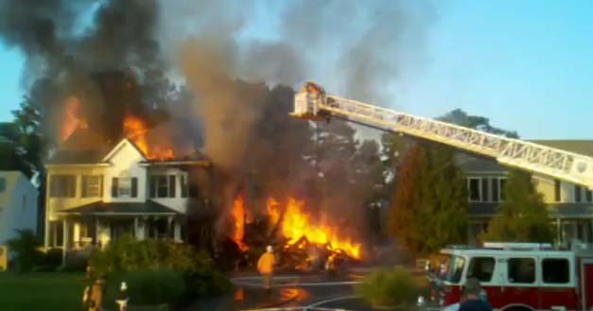
WHY?
Virginia has Fires

Slide 16
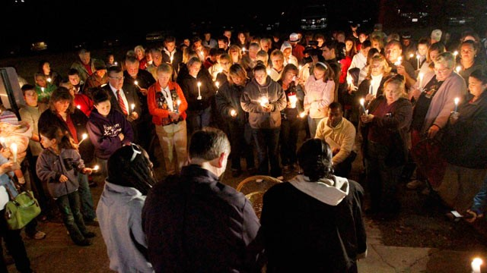
WHY?
Virginia has PEOPLE

Slide 17
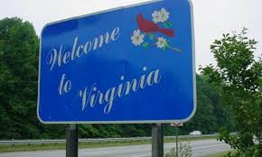
WHY?
Virginia needs Christ

Slide 18
Titus 3:1b – to be ready for every good work
Titus 3: 14 – And let our people also learn to maintain good works, to meet urgent needs, that they may not be unfruitful

Slide 19
WHY NOT JUST DR?
At least 80% of those we train never respond
DR does not empower the local church to respond
All responses are local
More people responding more often

Slide 20
Faces of Ready Church
GOteams met the crisis needs in their Jerusalem under the authority of the local church. Ready Church GOteams are well versed in Disaster Relief protocols and procedures.

Slide 21
Faces of Ready Church
A Ready Church responds outside their Jerusalem under the direction of their State Disaster Relief Leader. They meet the full requirements set forward by Southern Baptist Disaster Relief Roundtable.

Slide 22
Faces of Ready Church
A Ready Church responds to international needs under the direction of Baptist Global Response. Meeting all the requirements set forward by BGR.

Slide 23
Faces of Ready Church
A Ready Church desires to meet the construction needs of other churches, families and other entities under the direction of the local church, state convention/association or other entity.

Slide 24
Faces of Ready Church
A Ready Church participates in the long term rebuilding efforts after a disaster under the direction of the North American Mission Board or the impacted State Convention.

Slide 25
Benchmarks of excellence
Evangelism
Safety
Spiritual First Aid
Structure (ICS)
Feeding
Committed to Respond

Slide 26
What happens if the event is more than they can handle?

Slide 27





They have partners!
42 State Conventions

