Slide 3
Start with Boys to Raise Godly Men
Mike Young
Noble Warriors

Slide 4
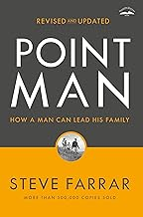
Point Man: How A Man Can Lead his Family by Steve Farrar
Chapter 2: Save the Boys
Thirty years ago, Washington Post columnist William Raspberry wrote these prescient words that still stand true today: “If I could offer a single prescription for the survival of America… it would be: restore the family. And if you asked me how to do it, my answer –doubtlessly oversimplified- would be: save the boys.”

Slide 5
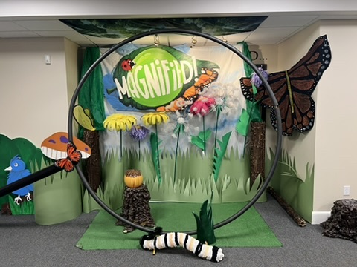

Slide 6
Let’s Connect
Name
Email
Church Name
Church Role
Question for Mike

Slide 7
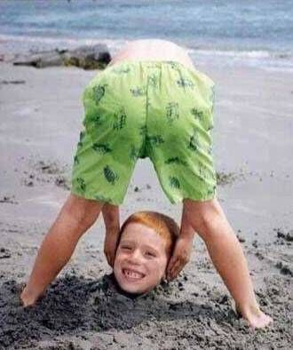
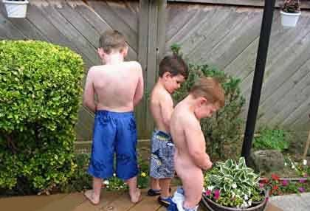
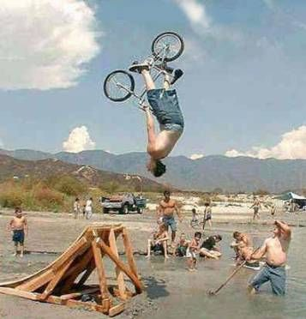
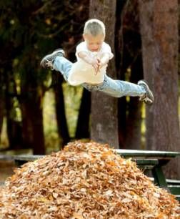

Slide 8
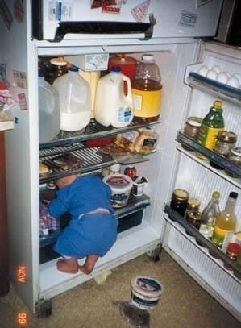
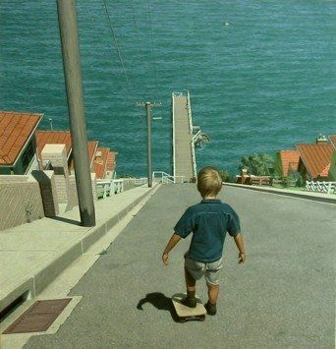
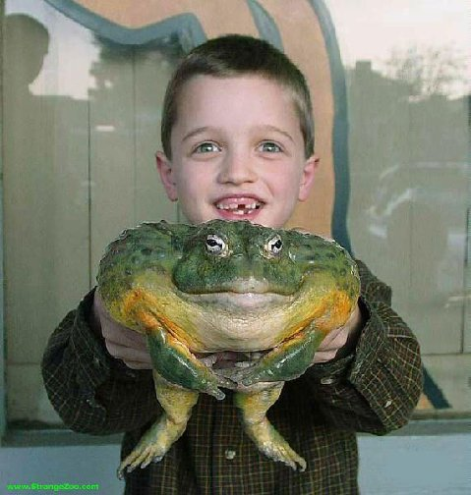
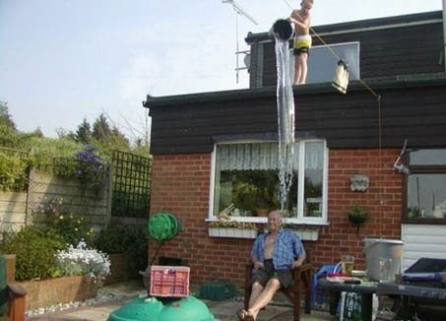

Slide 9
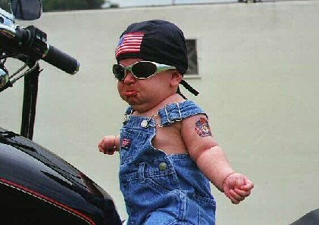
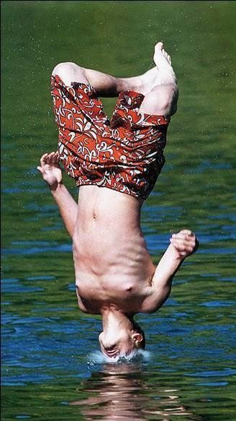
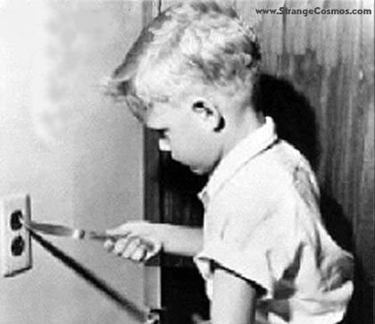
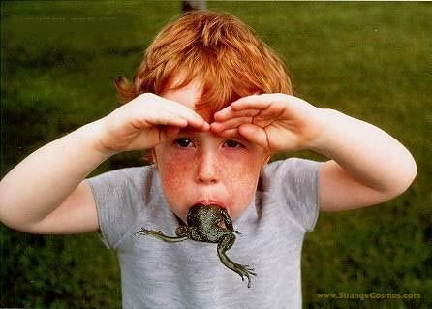

Slide 15
Wisdom from the Word
Genesis 1,2,3
Creation Order, Creation Mandate, Fall, Curse
Mark 1
Jesus Calls the Disciples
Matthew 28:19-20; Acts 1:8
Sent out for the King and Kingdom

Slide 16
Where are we?
Boys are losing ground
Over 70% of boys leave the church
No clear vision of manhood
Healthy role models are few

Slide 17
Let’s Connect
Name
Email
Church Name
Church Role
Question for Mike

Slide 18
How did we get here?
Feminism - Equality
Androgenization – Sameness
Feminization of Boys
Failure of Boys

Slide 19
In General
Leverage creativity, competition, and competence
Focus on application
Avoid comparisons and shame
Create the WOW factor!
Allow for mistakes and recovery.

Slide 20
At Your Church
Gender segregation
Recruit men to teach boys
Less sitting, more movement
Practice discomfort
Build something!

Slide 21
In the Home..
Remember Deuteronomy 6:4-9
Equip Parents to disciple at home
Encourage Parents to disciple at home
Plan for parent training (especially dads!)

Slide 23
How Can Noble Warriors Help?
Resource Recommendations
Encouragement for men
Strategy training/equipping
The Manger Build, Dad’s Tools

Slide 24
Ministries
Kid’s Outdoor Zone
Trail Life
Christian Service Brigade (CSB)

Slide 25
Let’s Connect
Name
Email
Church Name
Church Role
Question for Mike

